Slide 1

FORGOTTEN KINGDOM BY TIRED_BUNCH

Slide 2
TEAM PROJECT
Forgotten kingdom is 2d scroling, sideview platformer and brawler, set in ruins of once great kingdom, that fell in oblivion. You fight your way into city encountering demanding terain and boss fights
This game reminisces old pixelart games we enjoyed, such as Mario and Disney's Aladdin, and brings back rush of defeating hard boss and finishing a level
Can be found here: team tired bunch main
Notes:
You should have a working knowledge
of basic object-oriented programming concepts and at least some experience
programming in C++.

Slide 3
TEAM MEMBERS
Dimitrije Ivković, tired one
Ranko Damnjanović, exhausted one
Notes:
You should have a working knowledge
of basic object-oriented programming concepts and at least some experience
programming in C++.

Slide 4
GAME DESCRIPTION
This game uses simple menchanics, such as jump, double jump and slashing attack. There is no blocking, rolling or healing, so to beat the game one needs to master timing and learning bosses attack patern
Notes:
You should have a working knowledge
of basic object-oriented programming concepts and at least some experience
programming in C++.

Slide 5

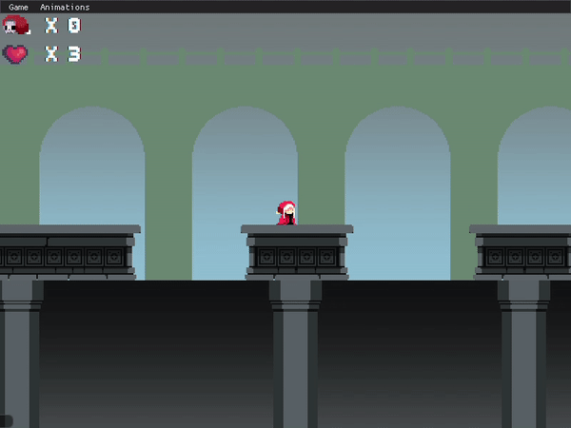

Notes:
You should have a working knowledge
of basic object-oriented programming concepts and at least some experience
programming in C++.

Slide 6
GAME DESCRIPTION
Player finds himself in ruins of an old kingdoms central city. He needs to find his way through unforgiving terrain where one step means plumeting to death. After reaching safety player is greeted by lone knight, and door that leeds to boss room...
Goal of the game is to clear paltforms and defeat boss without dying, or having smallest number of deaths
Notes:
You should have a working knowledge
of basic object-oriented programming concepts and at least some experience
programming in C++.

Slide 7
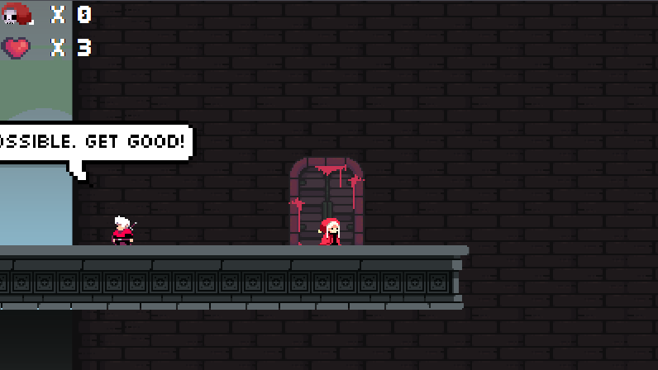
Notes:
You should have a working knowledge
of basic object-oriented programming concepts and at least some experience
programming in C++.

Slide 8
GAME DESCRIPTION
Game tests players skill with precise jumps when platforming and tests the players learning skill while he is trying to figure out the boss fight. One is not expected to finsih it without dying in his first playthrough.
Notes:
You should have a working knowledge
of basic object-oriented programming concepts and at least some experience
programming in C++.

Slide 9
GAME FEATURES
Character is controled by keyboard keys, A and D to move left and right, SPACE to jump, H to attack, J to interact and R to restart level
Implemented by Ranko Damnjanović
Notes:
You should have a working knowledge
of basic object-oriented programming concepts and at least some experience
programming in C++.

Slide 10
GAME FEATURES
Game has collision system, gravity, combat system, enemy ai, HUD and non interactive npcs
Implemented by Ranko Damnjanović, Dimitrije Ivković
Notes:
You should have a working knowledge
of basic object-oriented programming concepts and at least some experience
programming in C++.

Slide 11
GAME FEATURES
The level has two parts, platforming and boss fight room. Level is loaded from .txt file
Implemented by Dimitrije Ivković
Notes:
You should have a working knowledge
of basic object-oriented programming concepts and at least some experience
programming in C++.

Slide 12
GAME FEATURES
To win the game one must kill the boss, until then ,the player is stuck in dying and respawning cycle, rumping up death counter and ruinning score. At any time player can restart level and try getting better score
Implemented by Ranko Damnjanović, Dimitrije Ivković
Notes:
You should have a working knowledge
of basic object-oriented programming concepts and at least some experience
programming in C++.

Slide 13
GAME FEATURES
Level restarting
Implemented by Ranko Damnjanović, Dimitrije Ivković
Notes:
You should have a working knowledge
of basic object-oriented programming concepts and at least some experience
programming in C++.

Slide 14
Ranko
Dagger practice: Pulling and reviewing code
Ping pong feature: Ball speedup
Ping pong feature: second player AI, reset
Team game feature: bad controller and collision system
Team game feature: Physics system and start of collision system
Team game feature: Player fsm, collisions
Team game feature: Boss fsm, player animator
Team game feature: Combat system, collisions tweaking
Team game feature: Restart button, boss logic
Dimitrije
Dagger practice: creating team branch
Ping pong feature: Ball split
Corona time
Corona time
Team game feature: Boss sprites, spritesheets, tile system
Team game feature: Platform level, NPC animations
Team game feature: Boss room
Team game feature: HUD and end game mechanics
Notes:
You should have a working knowledge
of basic object-oriented programming concepts and at least some experience
programming in C++.

Slide 15
POSTMORTEM
Working on this game taught us to relly on each other with our responsibilites, and work as a team. It was also great opportunity to fortify c++ knowledge, and see how game industry works
Notes:
You should have a working knowledge
of basic object-oriented programming concepts and at least some experience
programming in C++.

Slide 16
POSTMORTEM
Planned to add: Interactive NPCs, loot, different attacks for boss and player, minions, unlockable powerups/classes
Notes:
You should have a working knowledge
of basic object-oriented programming concepts and at least some experience
programming in C++.

Slide 17
POSTMORTEM
Lost of a team member, faculty obligations plus covid-19 pandemic
Notes:
You should have a working knowledge
of basic object-oriented programming concepts and at least some experience
programming in C++.

Slide 18
POSTMORTEM
Lost time on Controller and Collisions - Ranko
Notes:
You should have a working knowledge
of basic object-oriented programming concepts and at least some experience
programming in C++.

Slide 19
POSTMORTEM
Better fps for potato GPUs
Notes:
You should have a working knowledge
of basic object-oriented programming concepts and at least some experience
programming in C++.

Slide 20
POSTMORTEM
Working with GIT
Working as a team
Gaming indusry basics
Thinking as a game developer
Notes:
You should have a working knowledge
of basic object-oriented programming concepts and at least some experience
programming in C++.

Slide 21
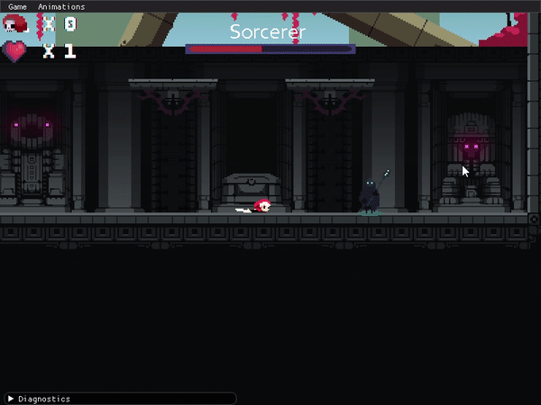
Notes:
You should have a working knowledge
of basic object-oriented programming concepts and at least some experience
programming in C++.

Slide 22
WE WANT TO SHARE...
We want to share our gratitude to Miroslav and Daniil for showing us the basics of game developement and helping us out with bunch of our coding problems while being tired from their own tasks.
Notes:
You should have a working knowledge
of basic object-oriented programming concepts and at least some experience
programming in C++.

Slide 23
THANK YOU!
Notes:
You should have a working knowledge
of basic object-oriented programming concepts and at least some experience
programming in C++.

Slide 24
QUESTIONS
Notes:
You should have a working knowledge
of basic object-oriented programming concepts and at least some experience
programming in C++.

